Slide 1

Computer Vision Video Content Analytics for Marketing Intelligence
Teddy Huang, PhD
Guest Researcher
California Institute of Technology
Tuesday, August 13, 2019

Slide 2

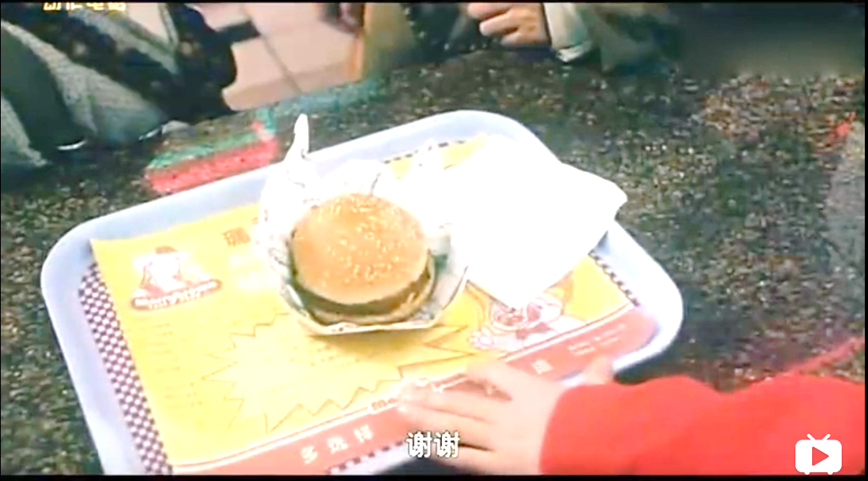

Marketing Data
Marketing data:
Impressive
Exaggerative
Deceptive
Massive
Truth for:
Rational purchasing
Intelligent product development
Computer vision:
Reveal the truth
Big Mac
This is so big, that is so small
https://www.bilibili.com/video/av23468710?from=search&seid=14946528699051298221

Slide 3

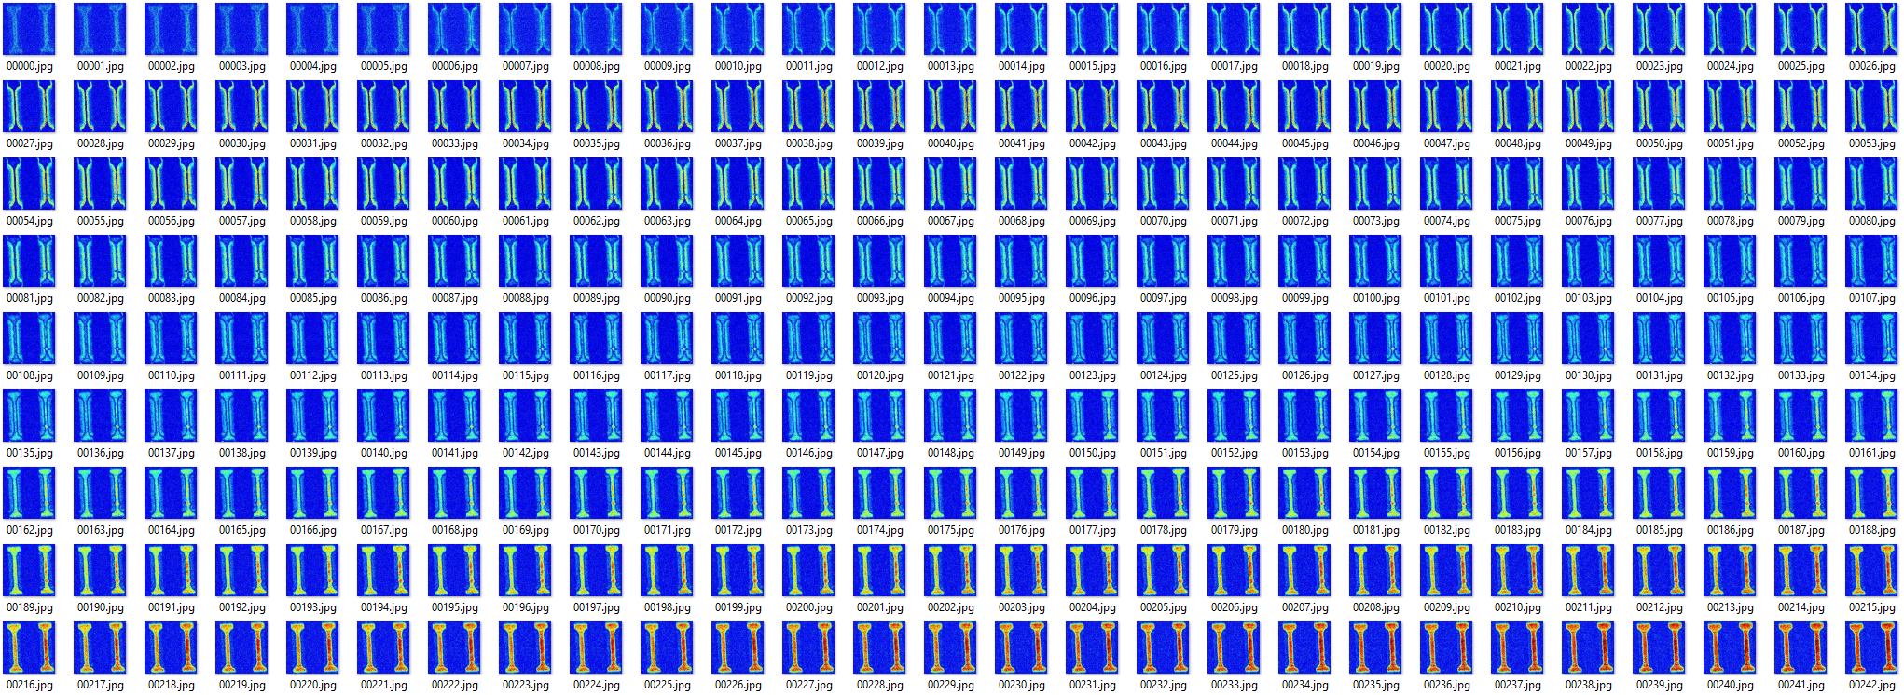
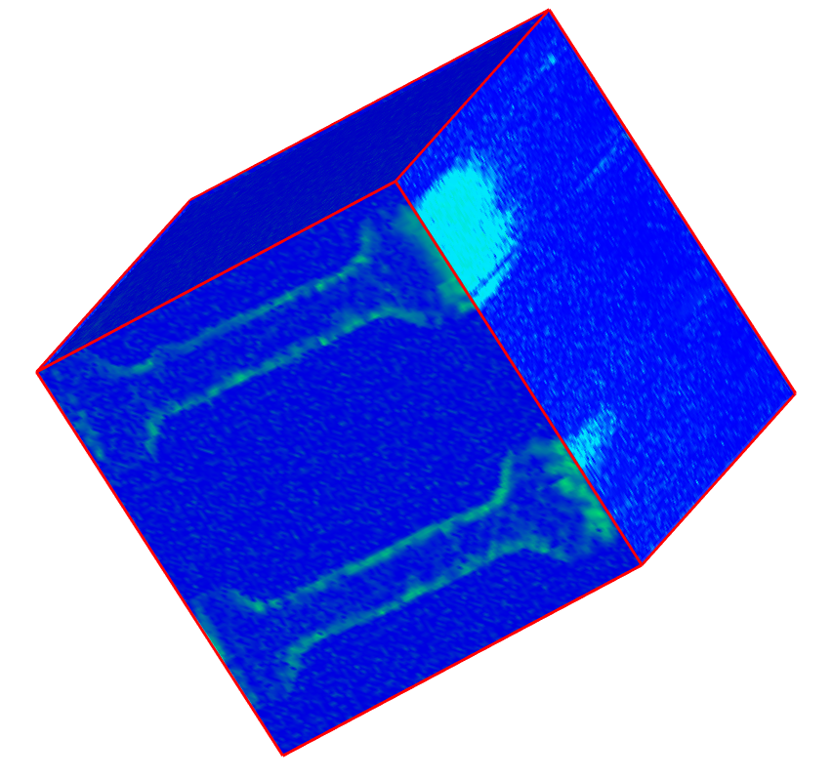
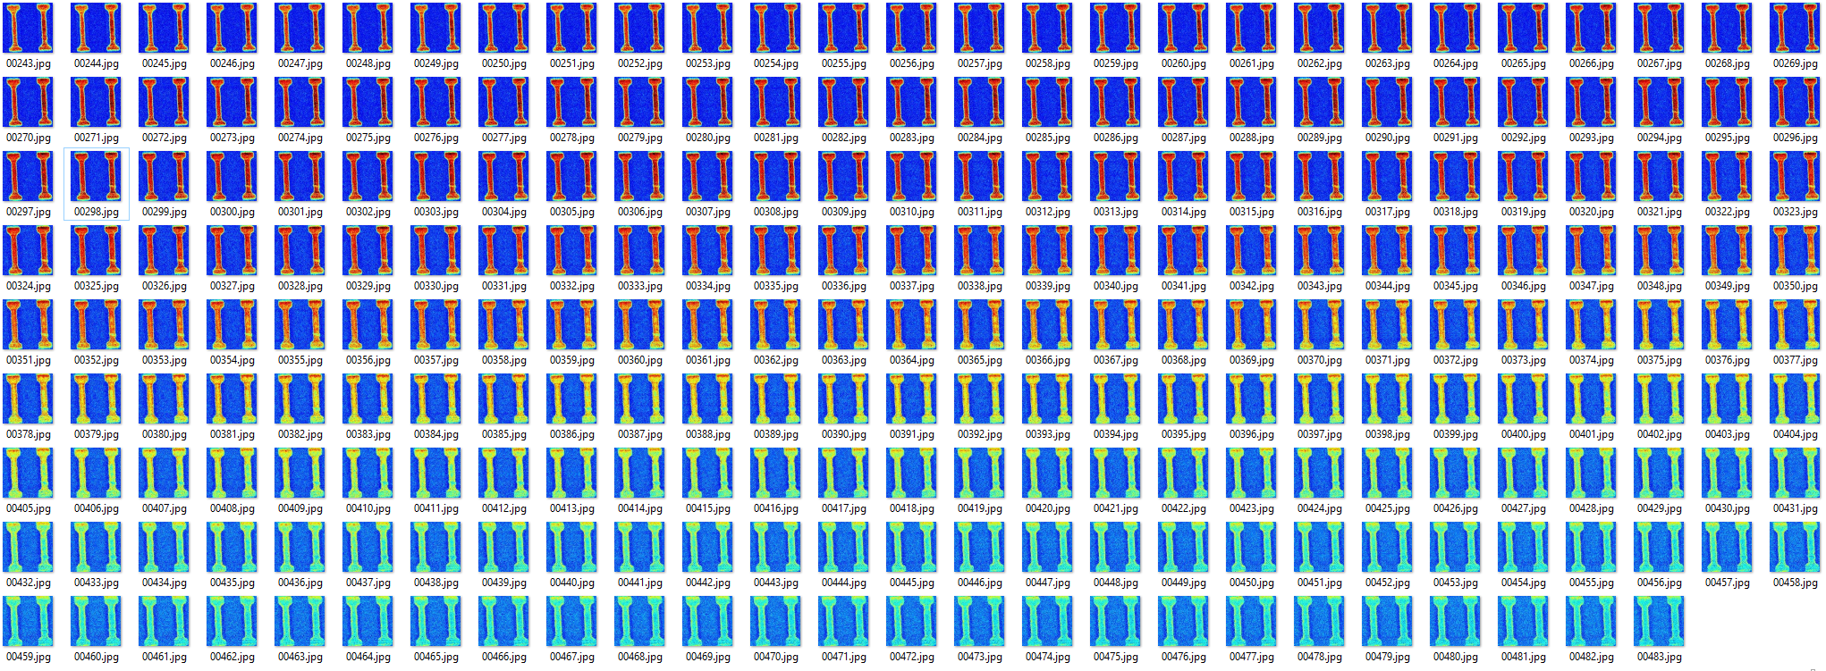
Data Extraction and Transformation
Performance of two devices on the same chip
From a video to a collection of frames, to a data cube
Marketing Video (18 s, 2.5 MB)
512 Extracted Frames, 7.1 MB
Data Cube: 128 x 128 x 484, 61 MB
3 µm x 3 µm
Movie.
Play it!
https://vimeo.com/255474034
Generally, > 100s of MB and messy
Removed 28 tailing frames
Easily get to GB level after interpolation

Slide 4
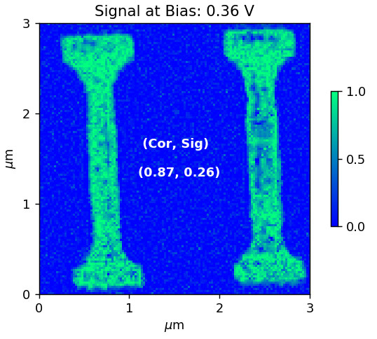
Data Mining: Correlation
Object detection and feature correlation for failure analysis
Normal

Slide 5
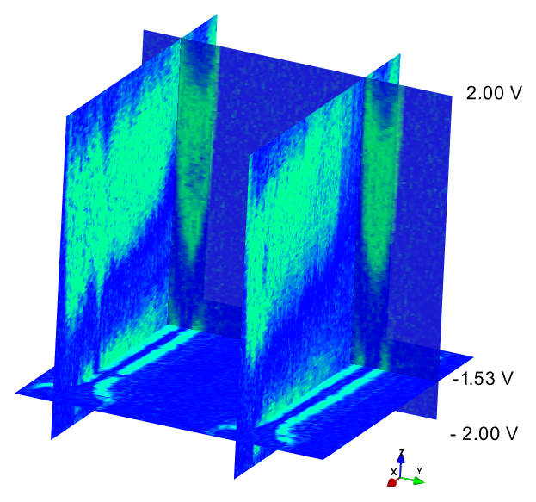
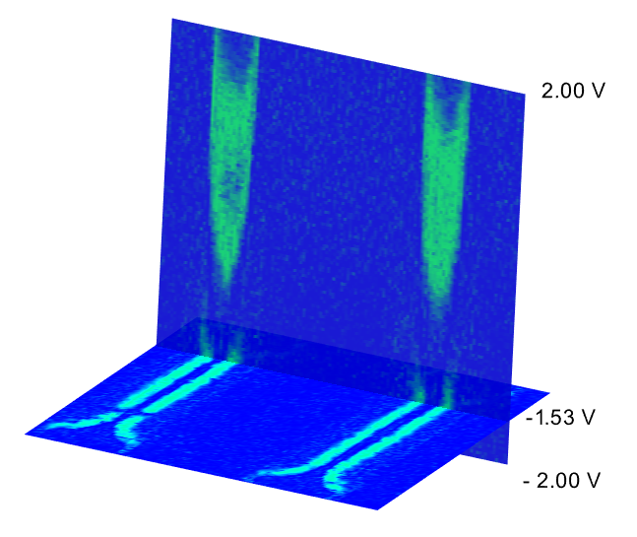
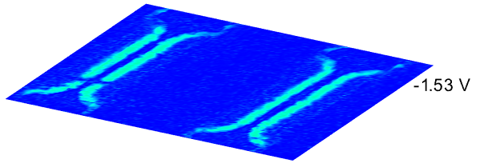
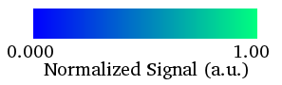
Data Mining: Depth Analysis
Data depth profiling along any angle
Spatial segmentation
defect
Bias
defect
defect

Slide 6
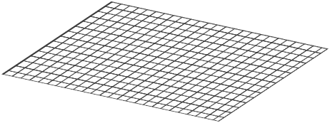
Data Mining: Spectral Analysis
Each pixel contains a spectrum
Spectrum per Pixel

Slide 7
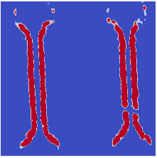
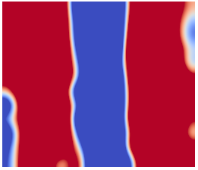
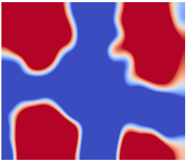
Data Mining: Spectral Analysis
Statistical representation:
Density plot
Normal
Defective

Slide 8
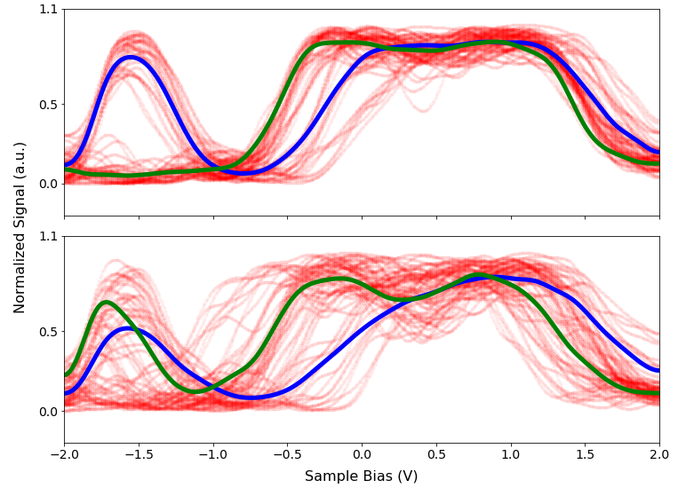
Data Mining: Spectral Analysis
64 Point Spectra from the Same Region
Density plot:
Clustering
Classification
Normal
Defective

Slide 9
Summary
Develop tools to see the insights of marketing data
Video content analytics: applies machine learning strategies to
reveal the truth behind ads
help customers for rational purchasing
help competitors to adjust product strategies

